Slide 1
HORIZONTAL COMMUNICATION
Definition; This refers to the interactions that occur between people holding the same hierarchical position or the same rank.
Method; Both formal and informal communication are used, but informal communication is used to a greater extent. It is more dependent on oral media.
Characteristics; it should be easy to understand, level of attentiveness should be considered, there should be broad-mindedness, and the message should be memorable.

Slide 2
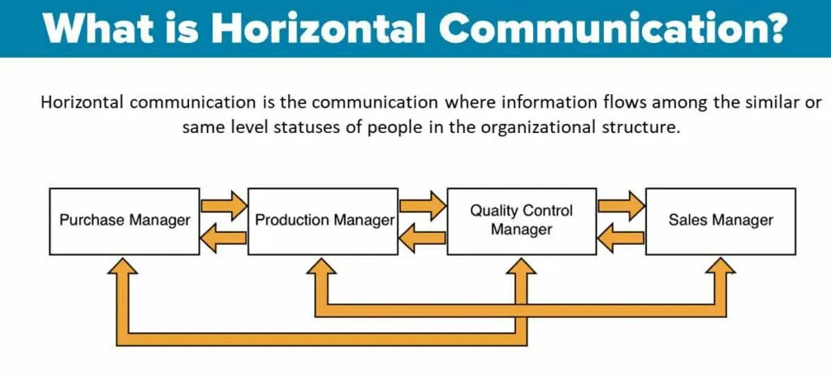
ILLUSTRATION

Slide 3
Advantages
Promotes teamwork and sense of security.
Easy to co-ordinate teams and tasks.
Inter-departmental communication.
Reduces misunderstandings amongst a group of people.
Strengthens group efforts.
Improves problem-solving skills and boosts creativity.
Distortion-free communication.

Slide 4
Disadvantages
Inter-departmental conflicts.
Ignoring vertical communication.
Discouraging attitude of top management.
Rivalling attitude.
Encourages fraudulent ideas.

Slide 5
VERTICAL COMMUNICATION
Definition; this refers to a communication strategy in which information, tasks and requests move upward and downward between senior management and low level subordinates. This communication occurs between people of different levels of importance or rank.
Method; it uses formal communication. It is mainly dependent on written media.

Slide 6
TYPES
UPWARD
DOWNWARD
This is from lower to higher level.
It is non-authoritative and non-directive.
The main purpose is to provide feedback.
It is in the form of reports, complaints, suggestions etc.
This is from higher to lower level.
It is authoritative and directive.
It’s main purpose is to get things done.
It is in a form of orders, instructions, circulars etc.

Slide 7
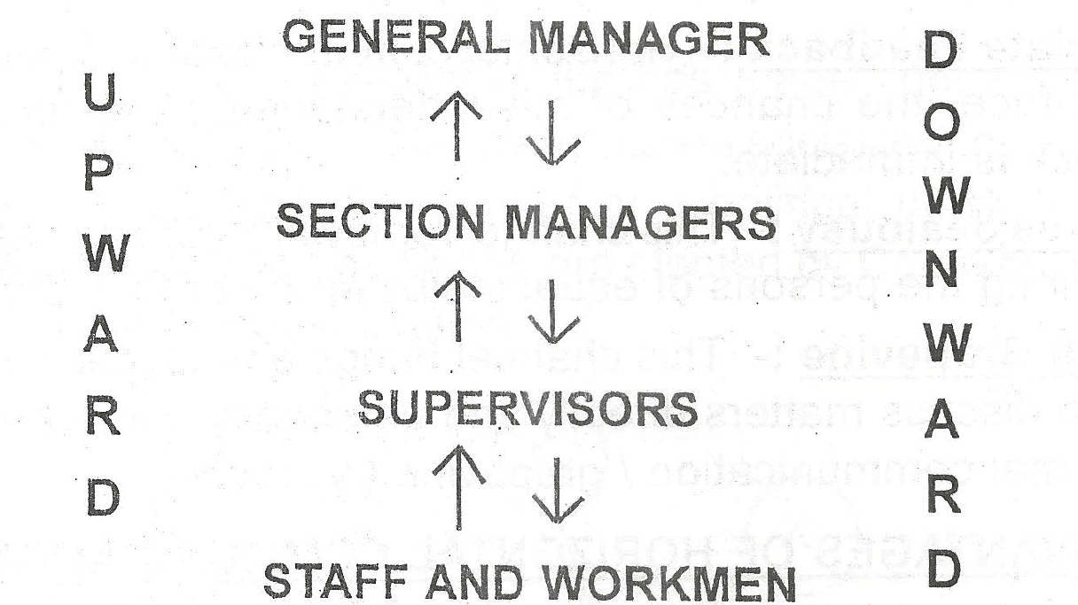
ILLUSTRATION

Slide 8
ADVANTAGES
Informing organizational goals and plans.
Communicating directives of superiors.
Conveying the message of subordinates.
Maintaining the chain of command (no bypassing).
Assigning jobs and evaluating performance.
Identifying the problems of subordinates.

Slide 9
DISADVANTAGES
Under communication and over communication.
Lack of honest feedback.
Delay in exchanging information.
Loss or distortion of information.
Reduces relationships.
Negligence of superiors.

Slide 10
DIFFERENCES
HORIZONTAL
VERTICAL
Purpose is to co-ordinate activities of departments.
Information flows between people holding same rank and status.
It is more informal.
It is mostly done through oral media and is free from distortion.
Occurs in short line.
Purpose is to provide instructions and receive feedback.
Information flows from superiors to subordinates and vice versa.
It is more formal.
It is mostly done through written media and may suffer from distortion.
Occurs through a long line of communication.

Slide 11
REFERENCES
Horizontal communication
thebusinesscommunication.com; https://thebusinesscommunication.com/what-is-horizontal-communication/
Vertical communication
dailyinfopk.com; https://www.dailyinfopk.com/2022/04/%20Vertical-Communication.html
Differences
thebusinesscommunication.com; https://thebusinesscommunication.com/what-is-horizontal-communication/

